Slide 1
{ }
CleanCode
One team. One Style. Every Save.
Farhan + Faraz
25K-0538 + 25K-0780
Automated code style standardization : built for student teams & finals season

Slide 2
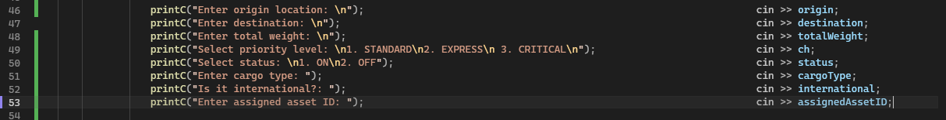
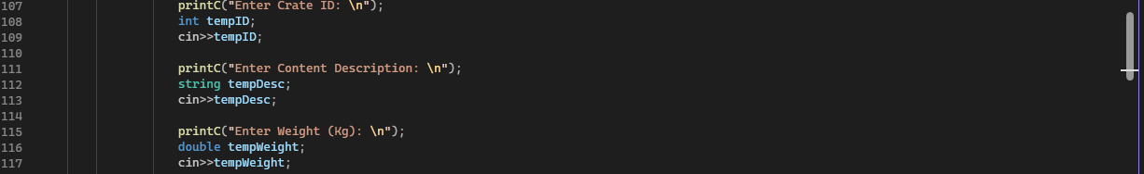
The Problem
Same project. Two teammates. Completely different code styles.
Your code
VS
Your friend's code

Slide 3
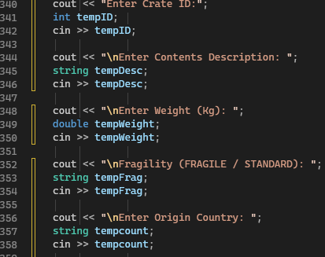
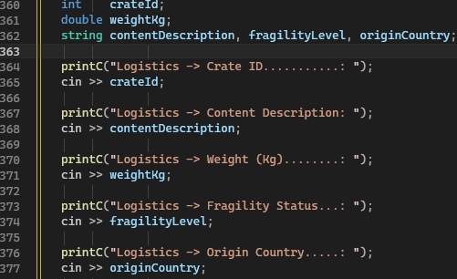
After CleanCode -> One Style
Both teammates' code now looks identical -> automatically, on every save.
❌ BEFORE (Friend)
✅ AFTER (Both)
→

Slide 4
{ }
Write code together.
Not just side by side.
"CleanCode. One team. One style. Every save."
If you ever worked on a group project and felt this frustration, CleanCode was built for you.
Set up in 2 minutes · Works on any C++ project · Runs on every save

